Slide 1

Software Design (swD392)
Ch21 - Client/Server Software Architecture Case Study - Banking System

Slide 2
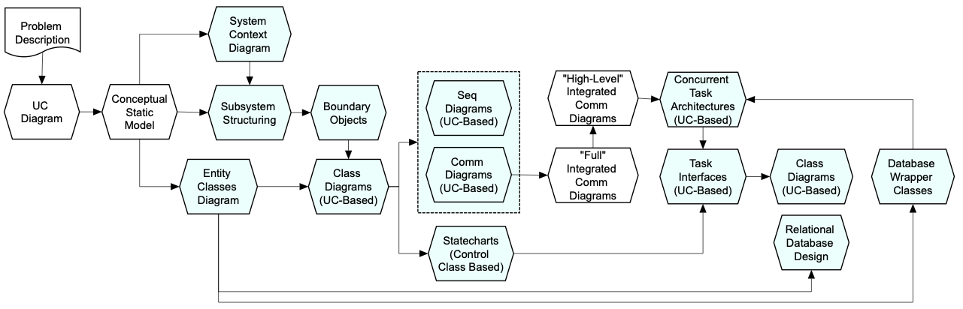
Main Contents
Problem Description
Software Modeling
Use Case Model
Static Modeling
Object Structuring
Dynamic Modeling
ATM Statechart
﻿Architectural Design
Integrated communication diagram
Detailed Design﻿﻿
Design of ATM Client Subsystem
﻿﻿Design of Bank Service Subsystem
﻿Relational Database Design
Deployment of Banking System

Slide 3
Problem Description 1/2
A bank has several automated teller machines (ATMs) that are geographically distributed and connected via a wide area network to a central server.
Each ATM machine has a card reader, a cash dispenser, a keyboard/display, and a receipt printer.
By using the ATM machine, a customer can withdraw cash from either a checking or savings account, query the balance of an account, or transfer funds from one account to another.
A transaction is initiated when a customer inserts an ATM card into the card reader.
Encoded on the magnetic strip on the back of the ATM card are the card number, the start date, and the expiration date.
Assuming the card is recognized, the system validates the ATM card to determine that the expiration date has not passed, that the user-entered personal identiﬁcation number, or PIN, matches the PIN maintained by the system, and that the card is not lost or stolen.
The customer is allowed three attempts to enter the correct PIN; the card is conﬁscated if the third attempt fails. Cards that have been reported lost or stolen are also conﬁscated.
Notes:
ATMs: automated teller machines
Checking account: tài khoản vãng lai, tài khoản thanh toán; Đây là một loại tài khoản tiền gửi mở tại ngân hàng hoặc một tổ chức tài chính nào đó nhằm mục đích cung cấp tài chính cho nhu cầu cá nhân một cách nhanh chóng và an toàn.

Slide 4
Problem Description 2/2
If the PIN is validated satisfactorily, the customer is prompted for a withdrawal, query, or transfer transaction.
Before a withdrawal transaction can be approved, the system determines that sufﬁcient funds exist in the requested account, that the maximum daily limit will not be exceeded, and that there are sufﬁcient funds at the local cash dispenser.
If the transaction is approved, the requested amount of cash is dispensed, a receipt is printed that contains information about the transaction, and the card is ejected.
Before a transfer transaction can be approved, the system determines that the customer has at least two accounts and that there are sufﬁcient funds in the account to be debited.
For approved query and transfer requests, a receipt is printed and the card ejected. A customer may cancel a transaction at any time; the transaction is terminated, and the card is ejected. Customer records, account records, & debit card records are all maintained at the server.
An ATM operator may start up and close down the ATM to replenish the ATM cash dispenser and for routine maintenance.
It is assumed that functionality to open and close accounts and to create, update, and delete customer and debit card records is provided by an existing system and is not part of this problem.
Notes:
ATMs: automated teller machines

Slide 5
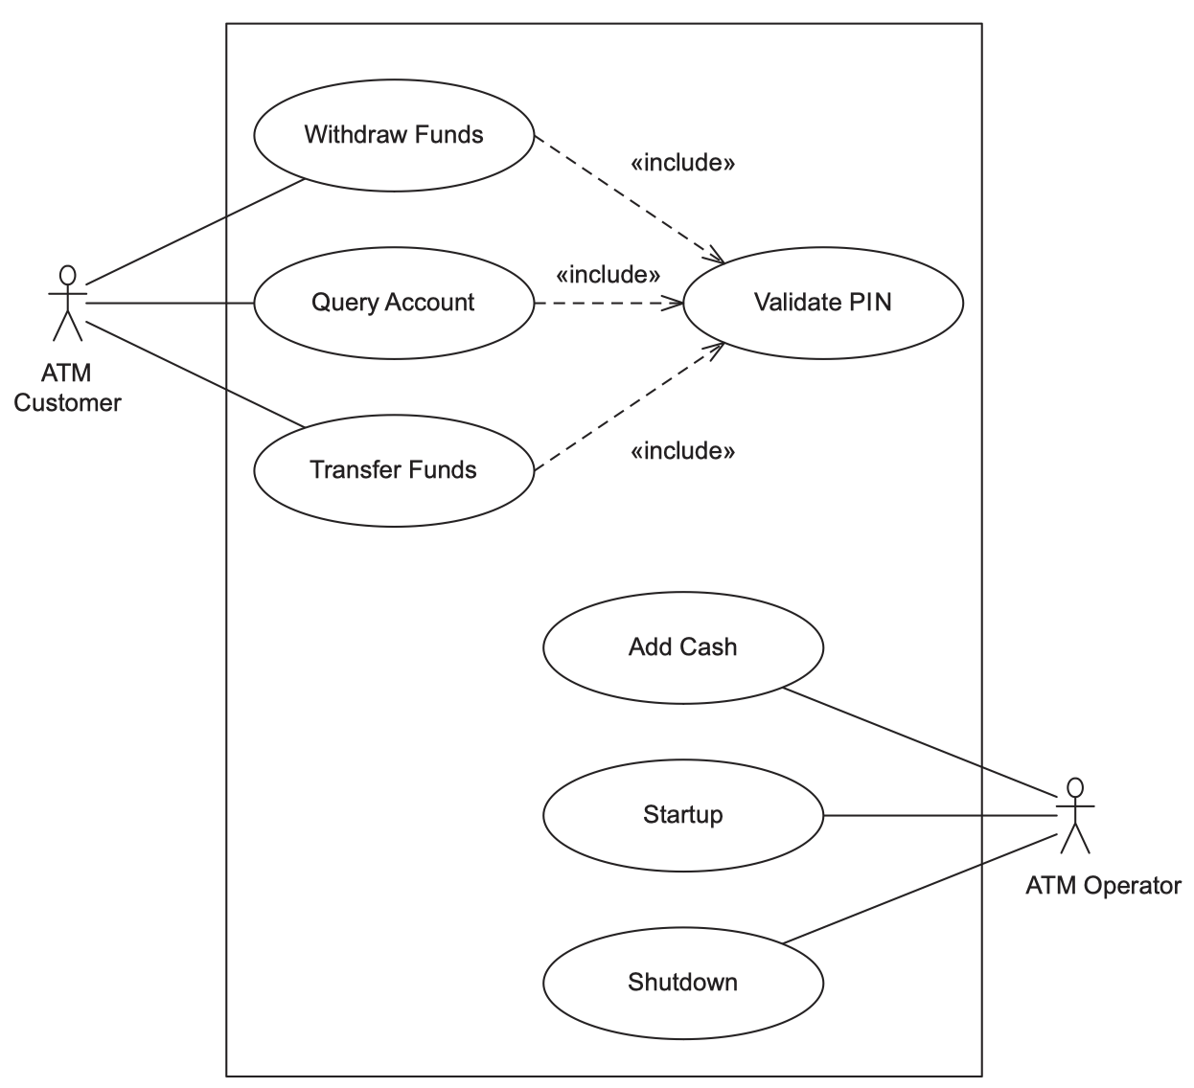
Use Case Model
The ATM customer can withdraw funds from a checking or savings account, query the balance of the account, and transfer funds from one account to another.
The ATM operator can shut down the ATM, replenish the ATM cash dispenser, & start the ATM
ATM Customer UC specs
=> Ch21, pages 374-376
Notes:
Replenish: bổ sung
Dispenser: máy rút

Slide 6
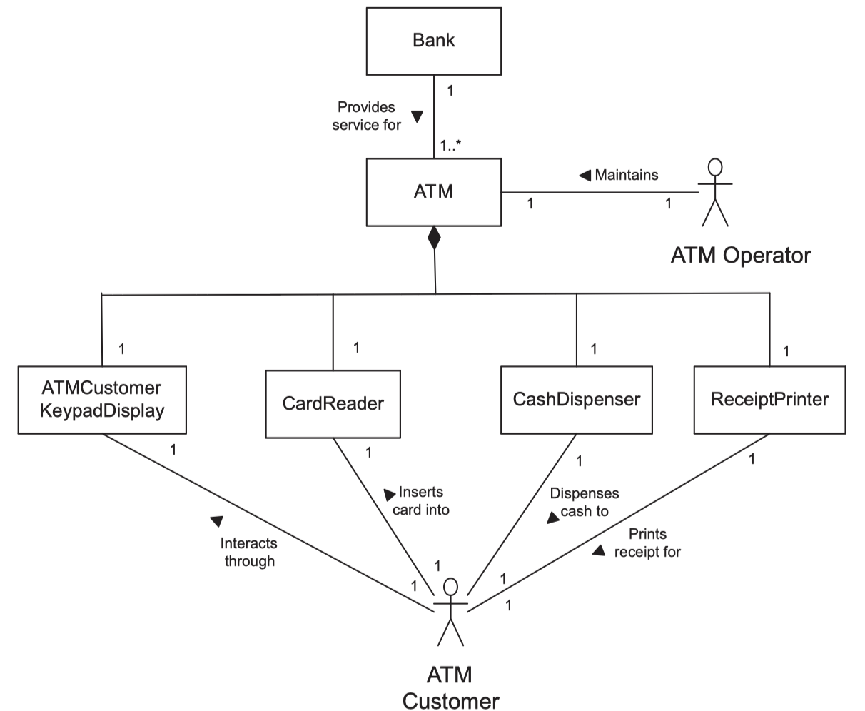
Static Modeling Conceptual static model
The conceptual static model of the problem domain is given in the class diagram below
Notes:
A bank has several ATMs. Each ATM is modeled as a composite class consisting of a Card Reader, a Cash Dispenser, a Receipt Printer, and a keyboard/display through which the user interacts, the ATM Customer Keyboard Display. The ATM Customer actor inserts the card into the Card Reader and responds to system prompts though the ATM Customer Keyboard Display. The Cash Dispenser dispenses cash to the ATM Customer actor. The Receipt Printer prints a receipt for the ATM Customer actor. In addition, the Operator actor is a user whose job is to maintain the ATM.

Slide 7
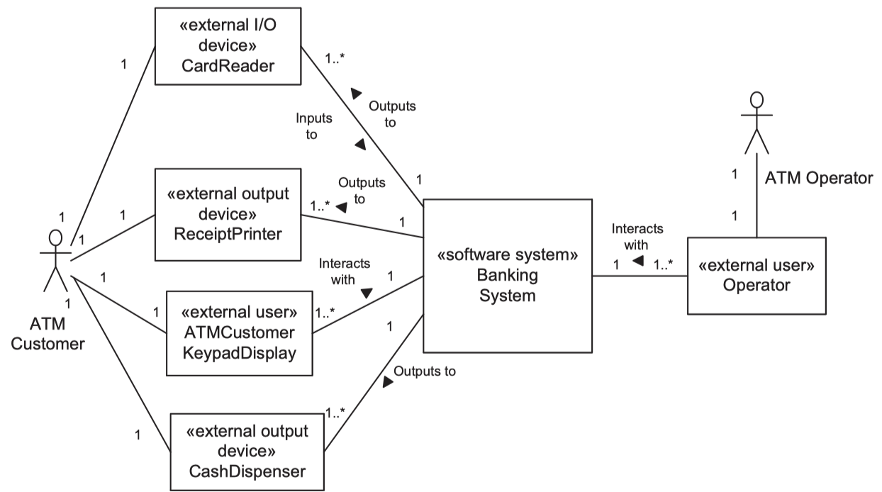
Static Modeling Static Modeling of the System Context
This is to show the external classes to which the Banking System, shown as one aggregate class, has to interface
Notes:
The ATM Operator interacts with the system via a keypad and display. The ATM Customer actor interacts with the system via four I/O devices, which are the card reader, cash dispenser, receipt printer, and ATM Customer keypad/display. From a total hardware/software system perspective, these I/O devices are part of the system. From a software perspective, the I/O devices are external to the software system. On the software system context class diagram, the I/O devices are modeled as external classes, as shown.
The four external classes used by the ATM Customer actor are the Card Reader, the Cash Dispenser, the Receipt Printer, and the ATM Customer Keypad/Display; the Operator interacts with the system via a keyboard/display. Both Customer Keypad/ Display and Operator are modeled as external users

Slide 8
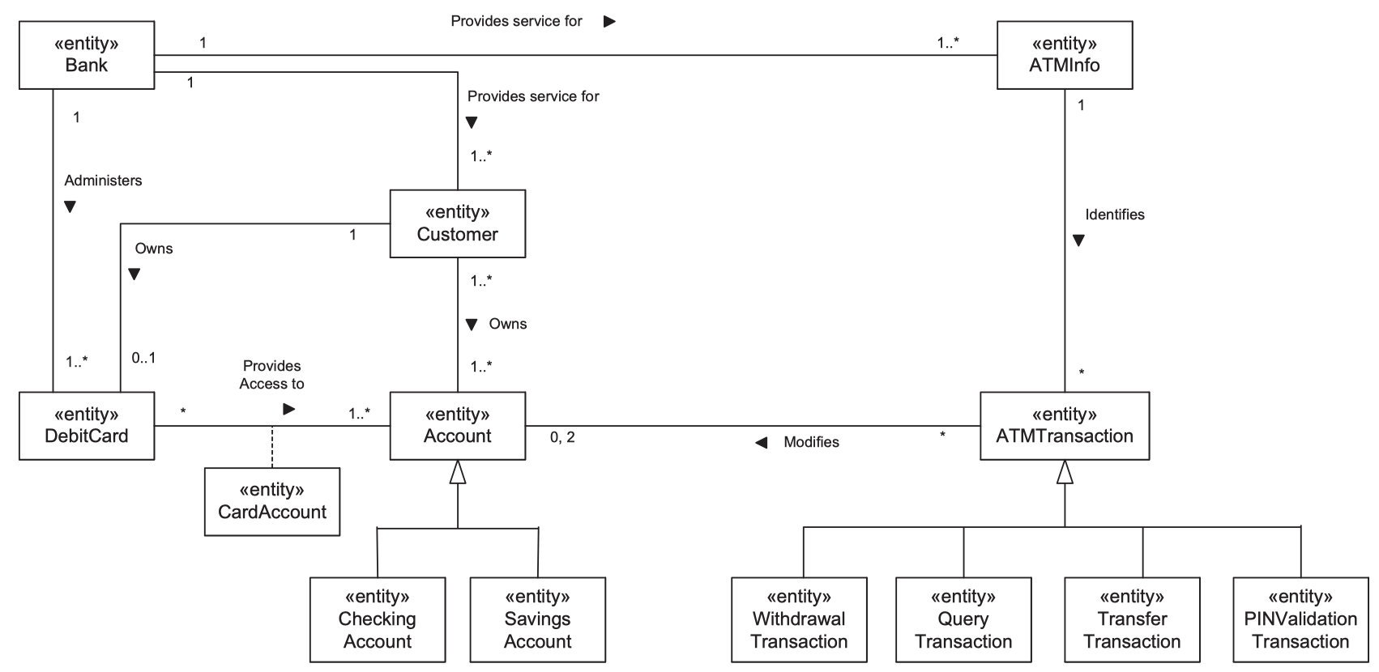
Static Modeling Static Modeling of the Entity Classes 1/2

Slide 9
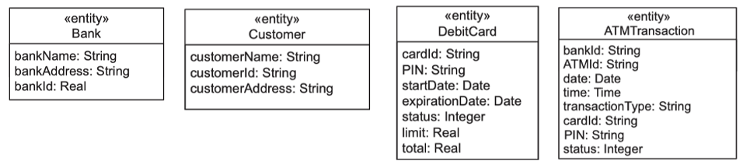
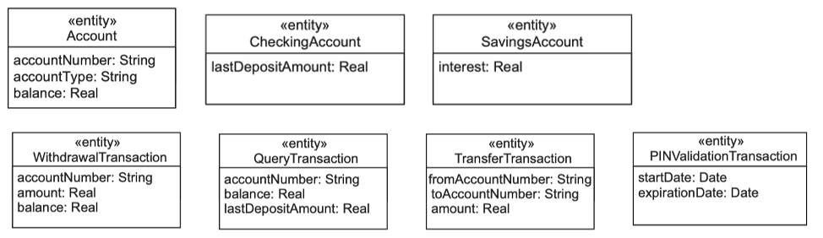
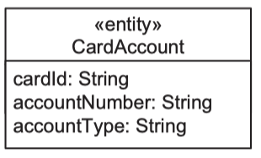
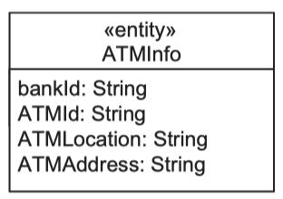
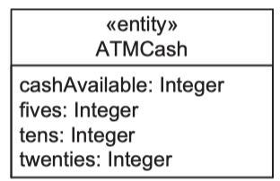
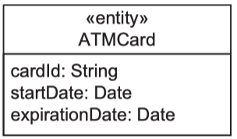
Static Modeling Static Modeling of the Entity Classes 2/2

Slide 10
Object Structuring
We next consider structuring the system into objects in preparation for deﬁning the dynamic model.
The object structuring criteria help determine the objects in the system.
After the objects and classes have been determined, a communication diagram or sequence diagram is developed for each use case to show the objects that participate in the use case and the dynamic sequence of interactions between them.

Slide 11
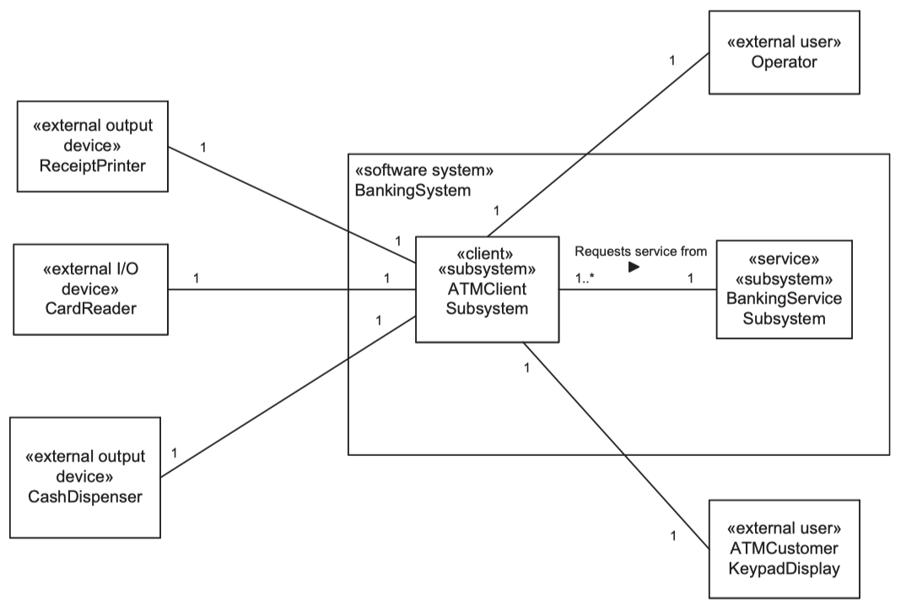
Object Structuring Client/Server Subsystem Structuring

Slide 12
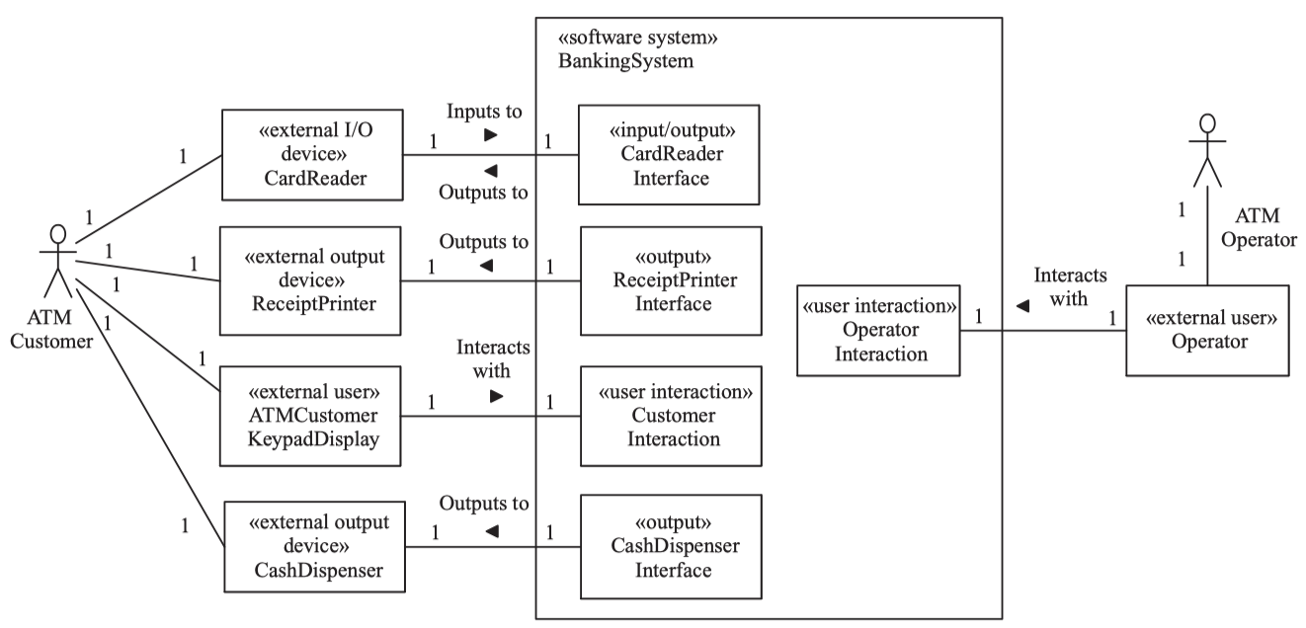
Object Structuring ATM Client’s Boundary Objects
Notes:
We design one boundary class for each external class.
The device I/O classes are the Card Reader Interface, through which ATM cards are read, the Cash Dispenser Interface, which dispenses cash, and the Receipt Printer Interface, which prints receipts.
There is also Customer Interaction, which is the user interaction class that interacts with the customer via the keyboard/display, displaying textual messages, prompting the customer, and receiving the customer’s inputs.
The Operator Interaction class is a user interaction class that interacts with the ATM operator, who replenishes the ATM machine with cash. There is one instance of each of these boundary classes for each ATM.

Slide 13
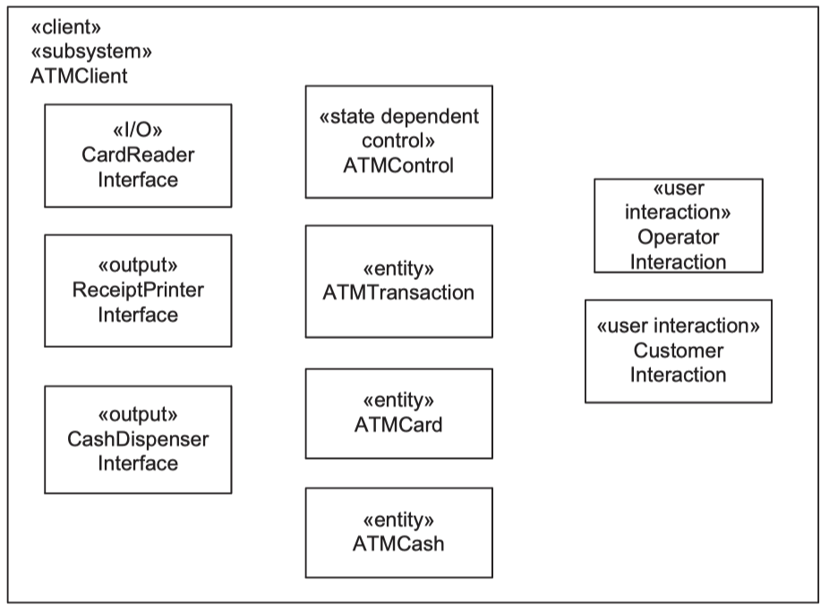
Object Structuring ATM Client’s Objects Participating in UCs
Validate PIN: CardReaderInterface, ATMCard, CustomerInteraction, ATMTransaction, ATMControl
Withdraw Funds: ATM Transaction, CashDispenserInterface, ATMCash, ReceiptPrinterInterface, ATMControl
Other UCs: Operator Interaction, ATMControl
Notes:
Validate PIN: we ﬁrst determine the need for the Card Reader Interface object to read the ATM card. The information read off the ATM card needs to be stored, so we identify the need for an entity object to store the ATM Card information. The Customer Interaction object is used for interacting with the customer via the keyboard/display, in this case to prompt for the PIN. The information to be sent to the Banking Service Subsystem for PIN validation is stored in an ATM Transaction. For PIN validation, the transaction information needs to contain the PIN number and the ATM Card number. To control the sequence in which actions at the ATM take place, we identify the need for a control object, ATM Control.
Withdraw Funds: the customer enters the amount to be withdrawn and the account to be debited, the system checks whether the withdrawal should be authorized, and if positive, dispenses the cash, prints the receipt, and ejects the card. For this use case, additional objects are needed. The information about the customer withdrawal, including the account number and withdrawal amount, needs to be stored in the ATM Transaction object. To dispense the cash, a Cash Dispenser Interface object is needed. We also need to maintain the amount of cash in the ATM, so we identify the need for an entity object called ATM Cash, which is decremented every time there is a cash withdrawal. Finally, we need a Receipt Printer Interface object to print the receipt. As before, the ATM Control object controls the sequencing of the use case.
Inspecting the other use cases reveals that one additional object is needed, namely, the Operator Interaction object, which participates in all use cases initiated by the Operator actor. The Operator Interaction object needs to send startup and shutdown events to ATM Control, because operator maintenance and ATM customer activities are mutually exclusive.

Slide 14
Object Structuring Object Structuring in Service Subsystem
Entity objects:
Customer,
Account, CheckingAccount, SavingAccount,
DebitCard, ATMTransaction, TransactionLog
Business logic objects:
PINValidationTransactionManager,
WithdrawalTransactionManager,
QueryTransactionManager
TransferTransactionManager

Slide 15
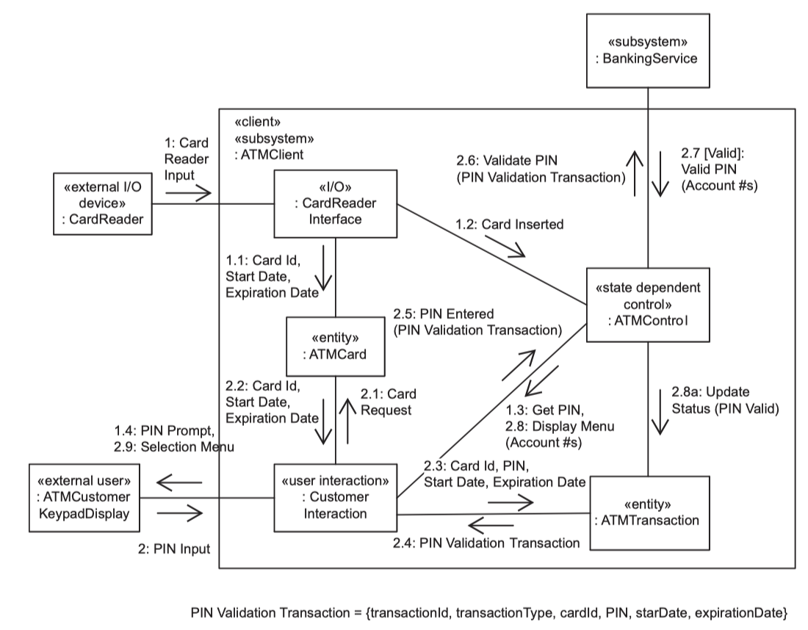
Dynamic Modeling Validate PIN UC – Communication Diagram
At the ATM Client

Slide 16
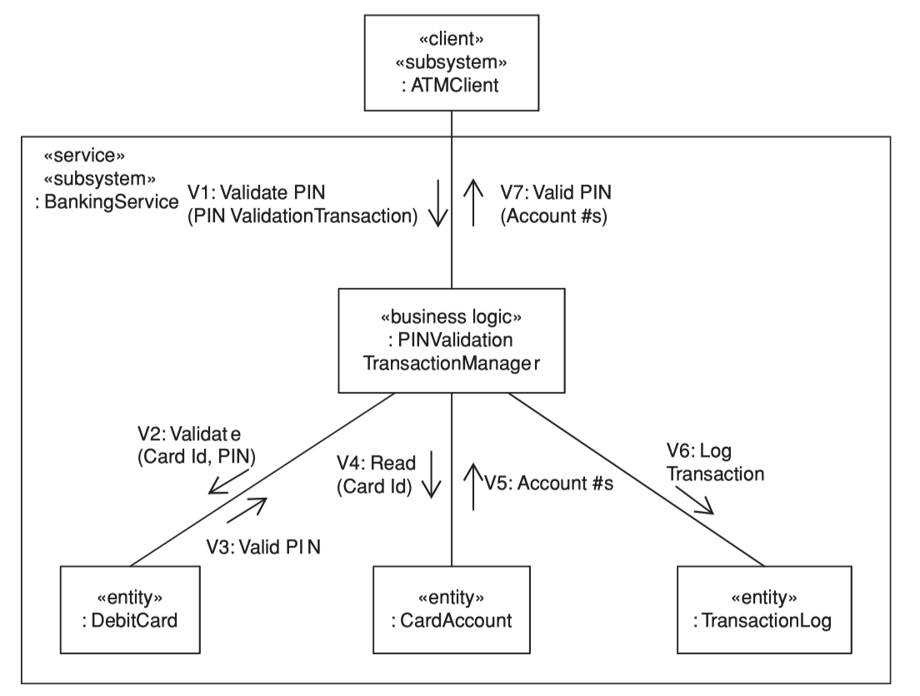
Dynamic Modeling Validate PIN UC – Communication Diagram
At the Banking Service

Slide 17
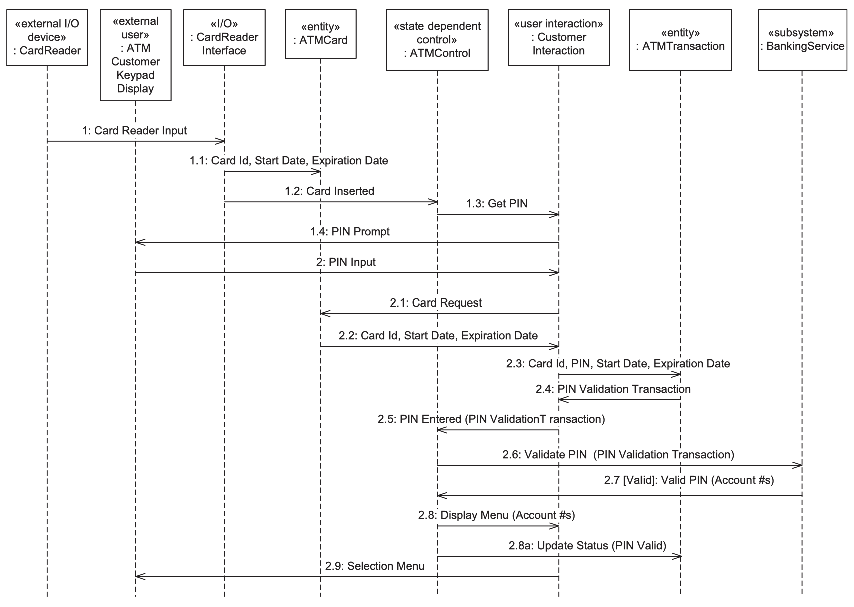
Dynamic Modeling Validate PIN UC – Sequence Diagram
At the ATM Client

Slide 18
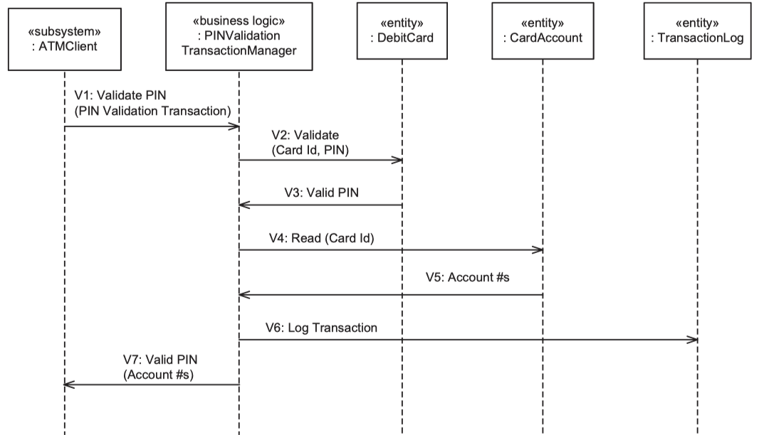
Dynamic Modeling Validate PIN UC – Sequence Diagram
At the Banking Service

Slide 19
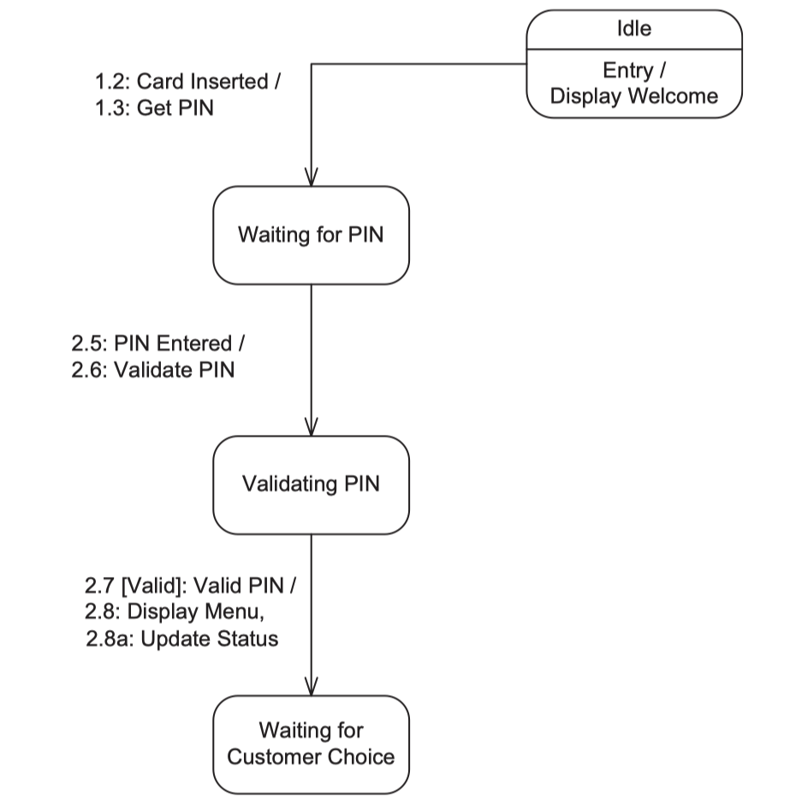
Dynamic Modeling Validate PIN UC – Statechart
Because the Validate PIN interaction diagram is state-dependent, it is also necessary to consider the ATM statechart (shown in this figure), which is executed by the ATM Control object. In particular, the interaction between the statechart and ATM Control (depicted on the communication diagram) needs to be considered

Slide 20
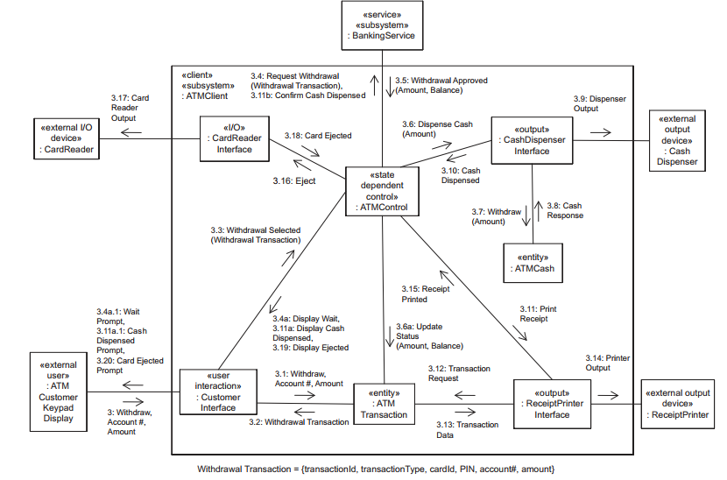
Dynamic Modeling Withdraw Funds – Communication Diagram
At the ATM Client

Slide 21
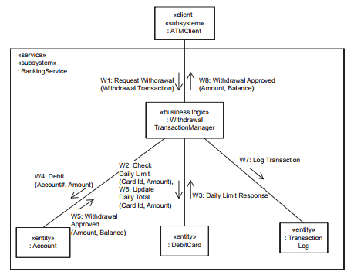
Dynamic Modeling Withdraw Funds – Communication Diagram
At the Banking Service

Slide 22
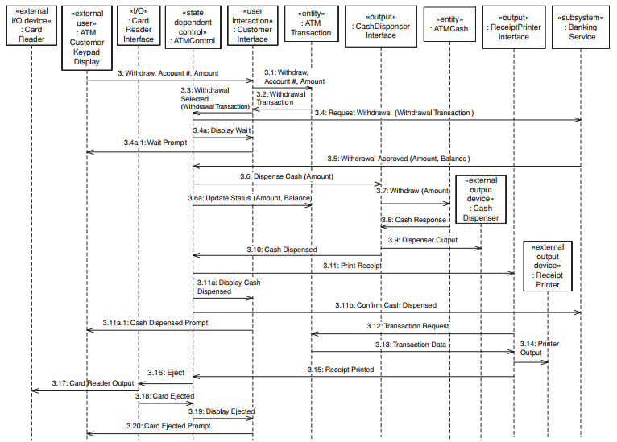
Dynamic Modeling Withdraw Funds – Sequence Diagram
At the ATM Client

Slide 23
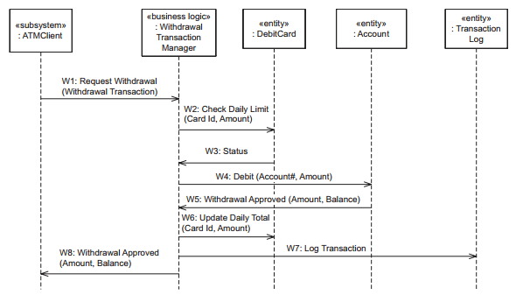
Dynamic Modeling Withdraw Funds – Sequence Diagram
At the Banking Service

Slide 24
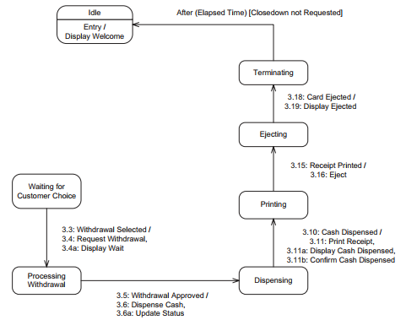
Dynamic Modeling Withdraw Funds – Statechart
This is state chart for ATM Control

Slide 25
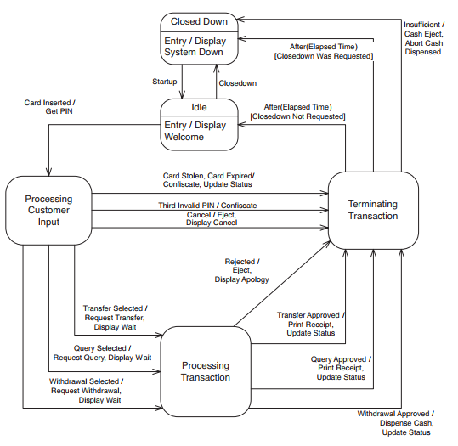
ATM Statechart ﻿Top-level state chart for ATM Control
﻿Five states are shown on the top-level statechart: Closed Down (which is the initial state), Idle, and three composite states, Processing Customer Input, Processing
﻿Transaction, & Terminating Transaction.
﻿At system initialization time, given by the event Startup, the ATM transitions from the initial Closed Down state to Idle state. The event Display Welcome is triggered on entry into Idle state. In Idle state, the ATM is waiting for a customer-initiated event.
Notes:
Confiscating: tịch thu

Slide 26
ATM Statechart ﻿ ﻿Processing Customer Input 1/3
﻿The Processing Customer Input composite state is decomposed into three substates
﻿Waiting for PIN: This substate is entered from Idle state when the customer inserts the card in the ATM, resulting in the Card Inserted event. In this state, the ATM waits for the customer to enter the PIN.
Validating PIN: This substate is entered when the customer enters the PIN. In this substate, the Banking Service validates the PIN.
Waiting for Customer Choice: This substate is entered as a result of a Valid PIN event, indicating a valid PIN was entered. In this state, the customer enters a selection: Withdraw, Transfer, or Query.

Slide 27
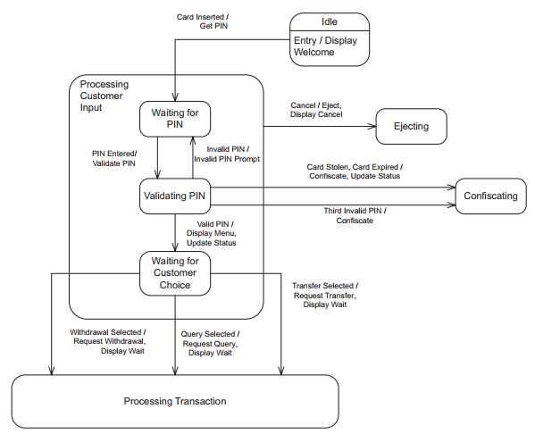
ATM Statechart ﻿ ﻿Processing Customer Input 2/3
﻿When a customer inserts an ATM card, the event Card Inserted causes the ATM to transition to the Waiting for PIN substate of the Processing Customer Input composite state

Slide 28
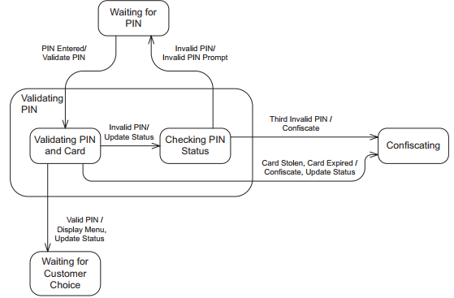
ATM Statechart ﻿ ﻿Processing Customer Input 3/3
﻿The Validating PIN substate is itself a composite state consisting of two substates: Validating PIN and Card as well as Checking PIN Status

Slide 29
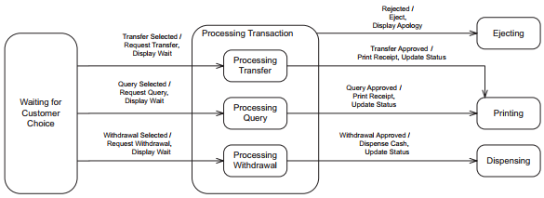
ATM Statechart ﻿ ﻿﻿Processing Transaction Composite State
﻿The Processing Transaction composite state is also decomposed into three substates, one for each transaction:
Processing Withdrawal,
Processing Transfer, ﻿
Processing Query. ﻿
Depending on the customer’s selection – for example, withdrawal – the appropriate substate within Processing Transaction – for example, Processing Withdrawal – is entered, during which the customer’s request is processed.

Slide 30
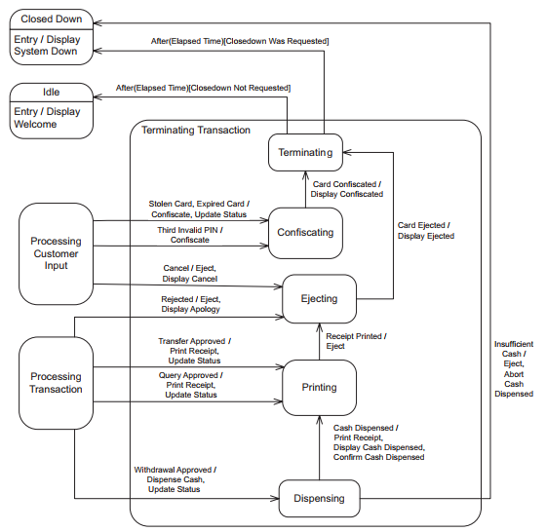
ATM Statechart ﻿ ﻿Terminating Transaction Composite State
﻿The Terminating Transaction composite state has substates for Dispensing, Printing, Ejecting, Confiscating, and Terminating.

Slide 31
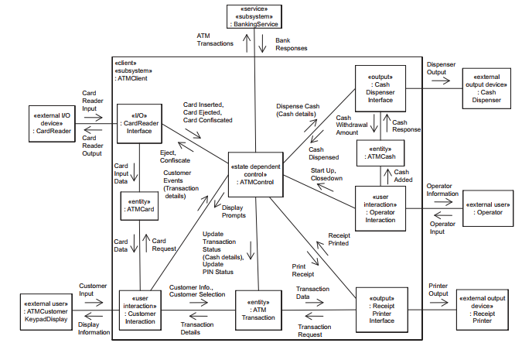
﻿Integrated communication diagram ﻿ATM Client subsystem

Slide 32
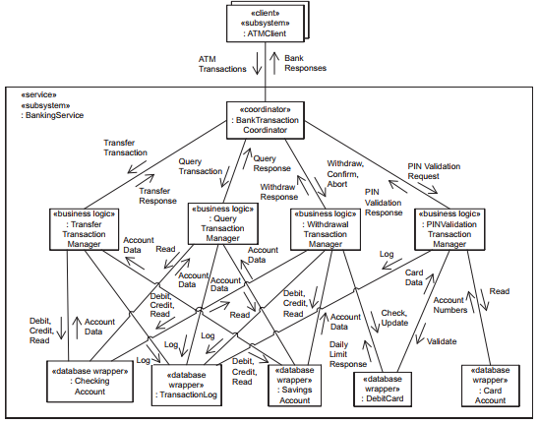
﻿Integrated communication diagram ﻿Banking Service subsystem

Slide 33
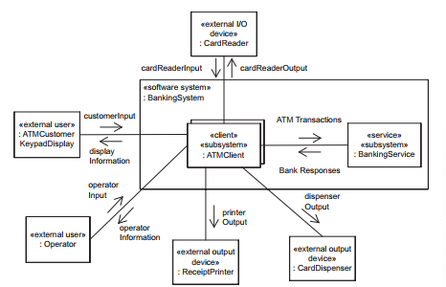
﻿ ﻿ Integrated communication diagram Structuring the System into Subsystems 1/3
﻿Multiple client/single service architectural pattern

Slide 34
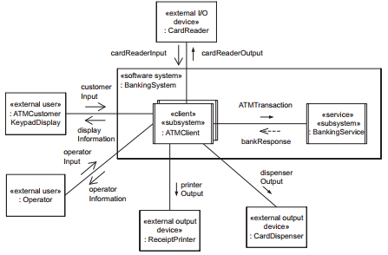
﻿ ﻿ Integrated communication diagram Structuring the System into Subsystems 2/3
﻿ ﻿Synchronous message communication with reply - This is from the considering the distributed nature of the application and defining the distributed message interfaces

Slide 35
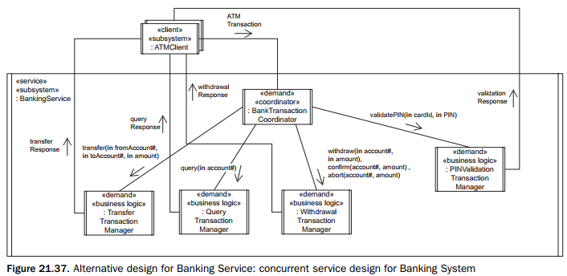
﻿ ﻿ Integrated communication diagram Structuring the System into Subsystems 3/3

Slide 36
﻿ ﻿﻿Design of ATM Client Subsystem ﻿Design the Concurrent Task Architecture

Slide 37
﻿ ﻿﻿Design of ATM Client Subsystem ﻿﻿Define the Task Interfaces

Slide 38
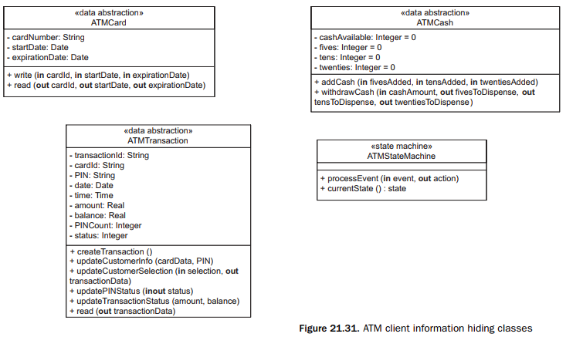
﻿ ﻿﻿Design of ATM Client Subsystem Design the Information Hiding Classes

Slide 39
﻿ ﻿﻿Design of Banking Service Subsystem Design the Concurrent Task Architecture

Slide 40
﻿ ﻿﻿Design of Banking Service Subsystem Design the Task Interfaces

Slide 41
﻿ ﻿﻿Design of Banking Service Subsystem Design the Information Hiding Classes 1/2

Slide 42
﻿ ﻿﻿Design of Banking Service Subsystem Design the Information Hiding Classes 2/2

Slide 43
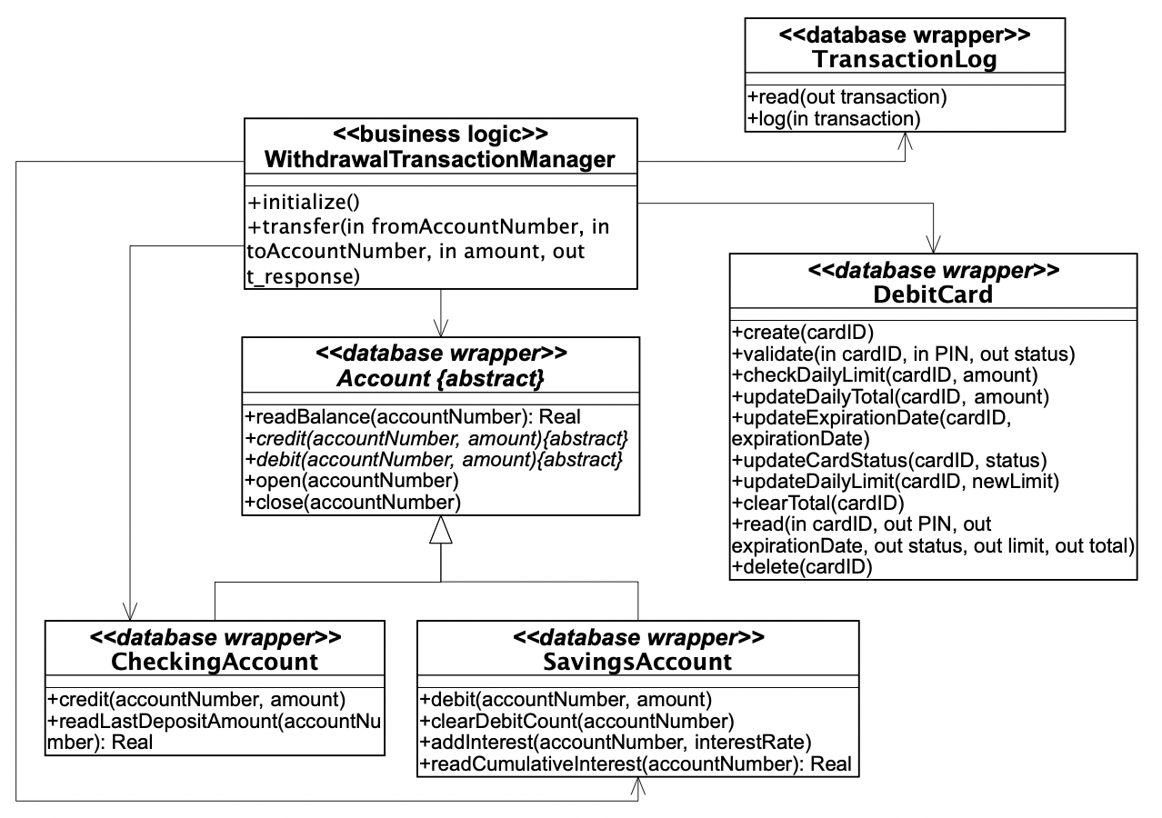
﻿ ﻿﻿Design of Banking Service Subsystem Class Diagram for the UC – Withdraw Funds

Slide 44
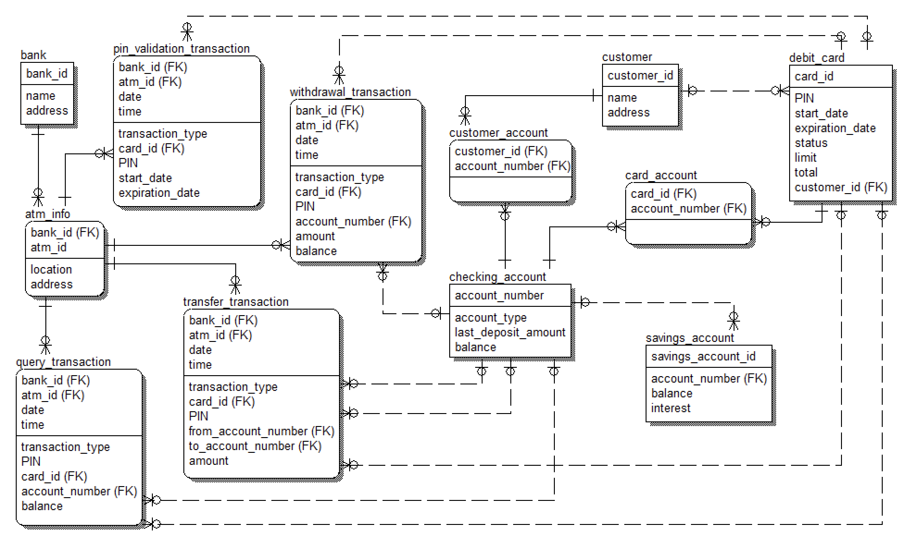
﻿Relational Database Design
﻿The data held by these entity classes need to be persistent and therefore need to be stored in a database
﻿the entity classes are designed as database wrapper classes
﻿the contents of the entity classes (as defined by the attributes of the entity classes) need to be stored in relational tables in the database

Slide 45
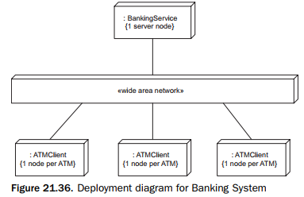
Deployment of Banking System
﻿Because this is a client/server system, there are multiple instances of the client subsystem and one instance of the service subsystem. Each subsystem instance executes on its own node, as depicted in the deployment diagram below. Thus, each instance of the ATM Client executes on an ATM node, and the one instance of the Banking Service executes on the server node.

Slide 46


